Slide 1
PROJECT TITLE : SECURE DATA HIDING IN IMAGES USING STEGANOGRAPHY
CAPSTONE PROJECT
Presented By : Nandana Santhosh
Student Name : Nandana Santhosh
College Name : St Joseph’s College of Engineering and Technology , Palai
Department : Electronics and Computer Engineering

Slide 2
OUTLINE
Problem Statement
Technology used
Wow factor
End users
Result
Conclusion
Git-hub Link
Future scope

Slide 3
Problem Statement
In an era where digital communication is widespread, the risk of unauthorized data access and cyber threats has significantly increased. While encryption techniques help secure data, they often attract attention, making the communication susceptible to interception. Steganography offers a covert way to protect sensitive information by embedding secret messages within digital images, making them virtually undetectable. This project focuses on implementing an efficient and secure image-based steganographic system using Python and OpenCV, ensuring confidential data transmission while maintaining the original image’s integrity.

Slide 4
Technology used
Platforms:
Windows
Python
Libraries & Tools:
OpenCV – For image processing and pixel manipulation
NumPy – For handling numerical operations on images
Pillow (PIL) – For image format handling

Slide 5
Wow factors
Enhanced Security
Undetectable Communication – Hidden messages blend seamlessly into images without altering their visual quality. Real-World Applications – Used in cybersecurity, digital watermarking, and confidential communication. Inspired by History – Steganography has been used for centuries, from ancient Greece to modern cryptography. User-Friendly Interface – A simple yet effective tool designed for ease of use, even for non-experts. Optimized Performance – Uses Python libraries like OpenCV and NumPy for fast and efficient processing.

Slide 6
End users
Cybersecurity Professionals – To securely transmit sensitive data without raising suspicion.
Government & Defense Agencies – For confidential communication and intelligence operations.
Financial Institutions – To protect sensitive transaction details from cyber threats.
Journalists & Whistleblowers – To safely share information while avoiding surveillance.
IT & Software Developers – To integrate steganography in security applications.
Legal & Corporate Sectors – For safeguarding confidential documents and contracts.
Content Creators & Digital Artists – To use watermarking techniques for copyright protection.

Slide 7
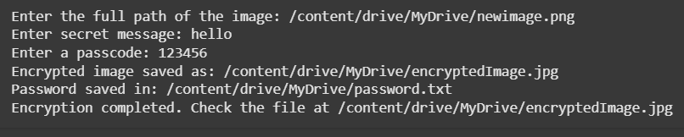
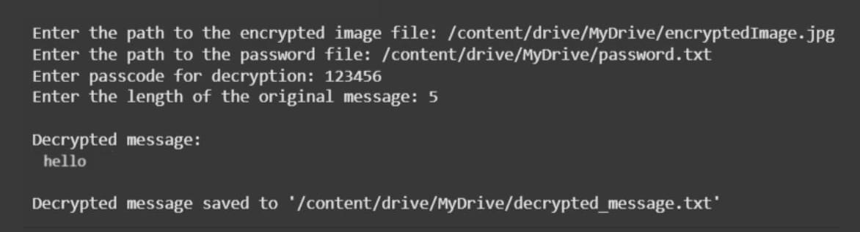
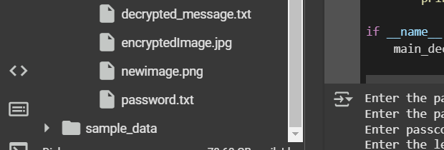
Results

Slide 8
Conclusion
In an era where data security is of utmost importance, traditional encryption alone may not be sufficient to protect sensitive information from unauthorized access. Our project enhances security by integrating steganography with encryption, ensuring that secret messages remain not only unreadable but also undetectable. By embedding encrypted data within digital images, we provide an additional layer of protection, making communication more secure and resistant to cyber threats.
This approach has vast applications in cybersecurity, defense, digital forensics, and copyright protection, making it a valuable tool in modern data security. Through our implementation, we demonstrate how steganography can reinforce digital privacy and ensure safe, covert communication in today's digital world.

Slide 9
GitHub Link
https://github.com/nandana-nr/Steganography-using-Python

Slide 10
Future scope(optional)
Enhanced Security Mechanisms – Future iterations can integrate AI-based encryption and deep learning models to detect and counter steganalysis attacks, making the system even more robust.
Support for Multiple Media Formats – Expanding beyond images, the project can incorporate audio, video, and text-based steganography, making hidden communication more versatile.
Real-time Steganography – Implementing real-time message hiding and extraction for secure live communication in fields like defense, journalism, and confidential corporate communications.

Slide 11
THANK YOU

